Slide 1
Work & Energy

Slide 2
Work and Energy
Energy is the ability to do work.
Work is:
The transfer of energy from one object to another object
The transformation of energy from one form to another form
Whenever anything happens in the universe work and energy are involved.

Slide 3
Calculating Work
W = FΔd
Where:
W represents work
F represents force
Δd represents displacement
Work and Energy are measured in Joules (J)
1 J = 1 N•m

Slide 4
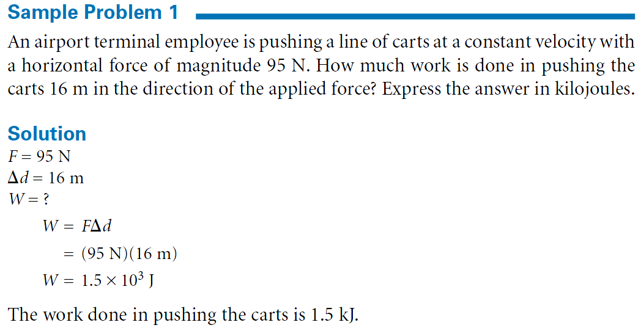

Slide 6
Conditions For Work
For work to be done:
A force must act on the object
The object must change position
The force must be parallel to the direction of motion
Note: If the force applied is perpendicular to the motion, no work is done.

Slide 7
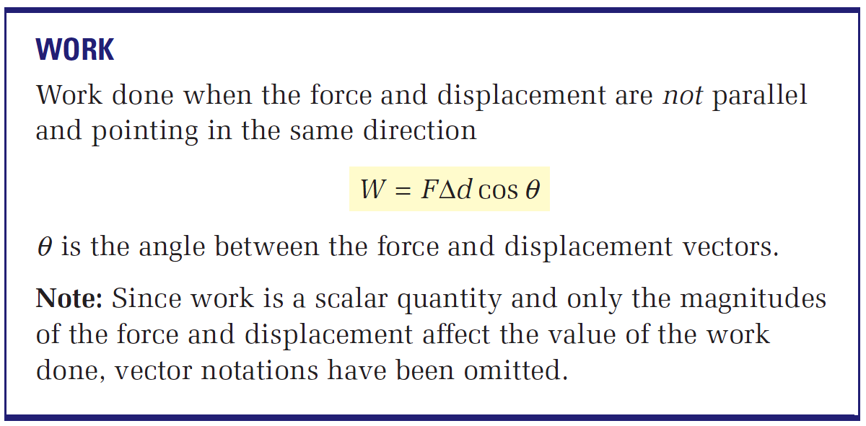

Slide 8
When Work Is Done
Condition | Work Done | Example

Slide 9






When Work Is Done - Solution
Condition | Work Done | Example

Slide 10
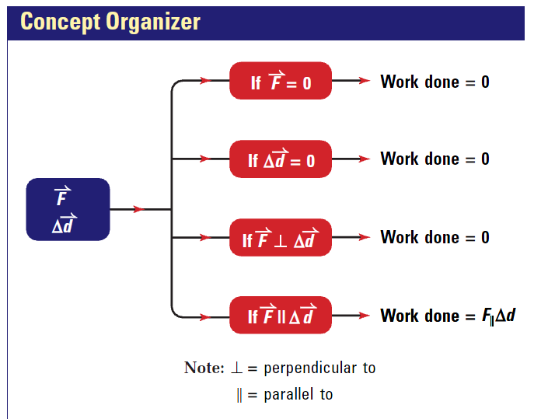

Slide 11
Positive and Negative Work
If the applied force is in the same direction as the motion, positive work is done.
e.g. The object speeds up
W = FΔd
If the applied force is in the opposite direction from the motion, negative work is done.
e.g. The object slows down
W = −FΔd

Slide 12
Sample Problem
A 0.1 Kg arrow is fired through a 0.9 m foam target and slows from a velocity of 100 m/s to 80 m/s in 0.01s.
What type of work is done?
How much work is done?
What is the acceleration
What is the force
What is the distance
What is the work

Slide 14
Consolidation
Work Homework / When is Work Done

Slide 15
When is Work Done?
Is work done when a person holds a book?
Force ? YES
Displacement? NO
Work? NO
Is work done when a spacecraft is drifting through space at constant velocity?
Force ? NO
Displacement? YES
Work? NO

Slide 16
Sample Problem 2
A woman pushes a lawnmower with a force of 150N at an angle of 35˚ down from the horizontal. The lawn is 10.0 m wide and requires 15 complete trips across and back. How much work does she do?
Given:
F = 150N width = 10.0m Θ = 35˚ 15 trips
Total distance → ∆d = 2(10.0m)(15) = 300 m
W = F x d cos Θ
W = (150 N) (300 m) (cos 35˚)
W = 36 861.8 J
W = 3.7 x 10⁴ J

Slide 17
Sample Problem #1
How much work will you do if you push a full recycling bin 33.5 m along a sidewalk using a horizontal force of 175 N?
Use: W = FΔd
Answer: 5860 J

Slide 18
Sample Problem #2
You do 45.8 J of work when you lift a bag of potatoes 0.752 m straight up using a vertical force. Find the magnitude of this applied force.
Use: W = FΔd
Answer: 60.9 N

Slide 19
Examples:
How much work do you do on a box if you push it 3.0 m along the floor an applied force of 125 N?
A frictional force of 42 N acts on a 25 kg curling stone as it slides 15 m along the ice. How much work does the force of friction do?

